Slide 1
UMD DATA605 - Big Data Systems NoSQL Stores
NoSQL Taxonomy
(Apache) HBase
Dr. GP Saggese
gsaggese@umd.edu
with thanks to Prof.
Alan Sussman (UMD)
Amol Deshpande (UMD) Oliver Kennedy (U. Buffalo)
Doug Thain (U. Notre Dame)

Slide 2
UMD DATA605 - Big Data Systems NoSQL Stores
NoSQL Taxonomy
(Apache) HBase

Slide 3
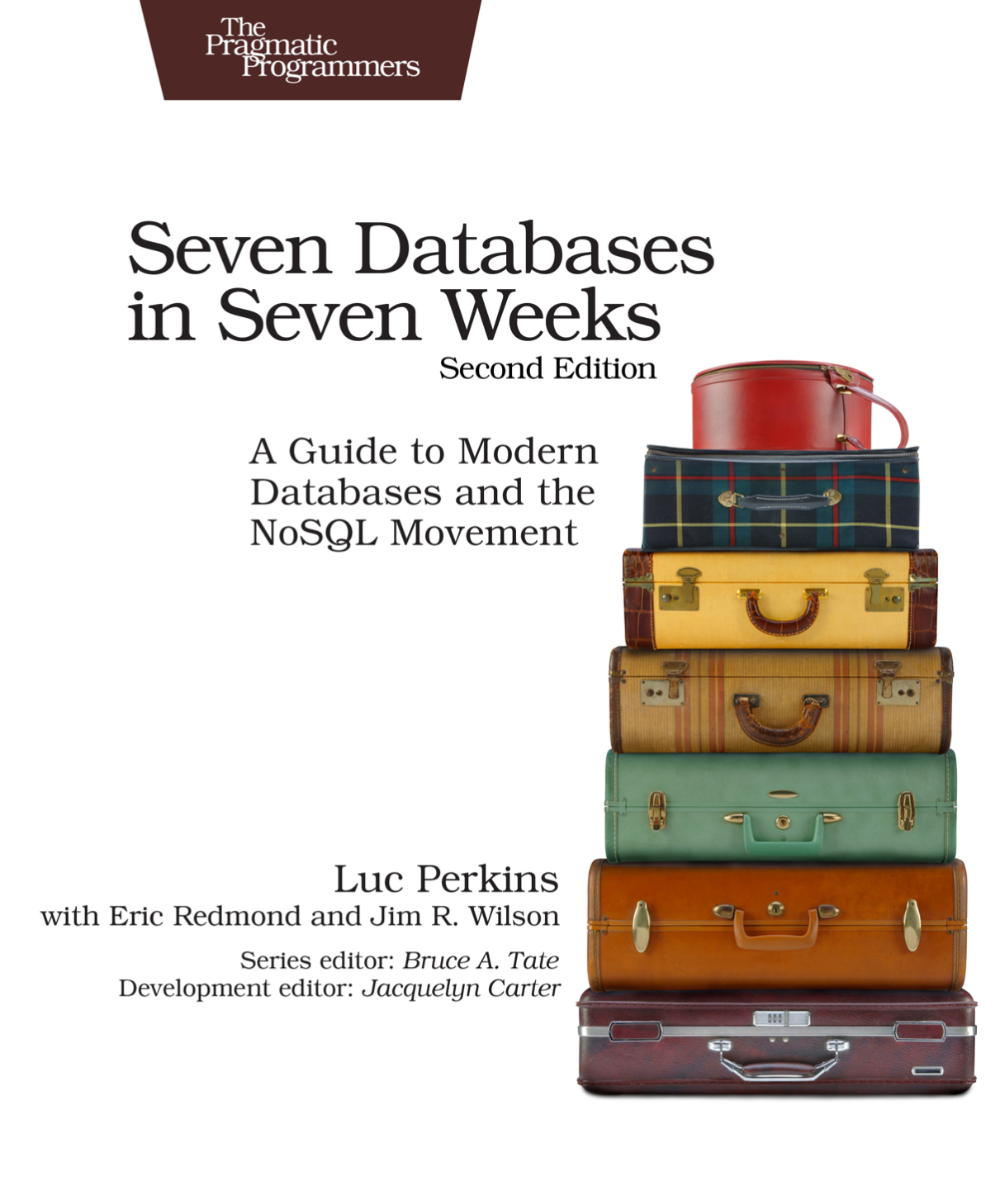
Resources
Concepts in the slides
Tutorial on MongoDB
Class project uses MongoDB
Silbershatz Chap 10.2
Nice high-level view:
Seven Databases in Seven Weeks, 2e

Slide 4
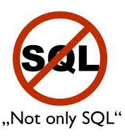
From SQL to NoSQL
DBs are central tools to big data
Around 2000s NoSQL “movement” started
New applications and constraints
Unclear if it stood for “No SQL”, “Not Only SQL”
Relational vs NoSQL stores implement different trade-offs
Different DBs with different worldviews and trade-offs
Schema vs schema-less
Rich vs fast query-ability
Strong consistency (ACID), weak, eventual consistency
APIs (SQL, REST)
Horizontal vs vertical scaling, sharding, replication schemes
Indexing for rapid lookup vs no indexing
Tuned for reads or writes, how much control over tuning
The user base has expanded
Different use cases and demands
IMO Postgres and Mongo cover 99% of use cases
Any data scientist / engineer needs to be familiar with both
“What DB solves my problem best?”
Polyglot model
Use more than one DB in each project
Relational DBs are not going to disappear any time soon

Slide 5
Issues with Relational DBs
Relational DBs have drawbacks
1) Application-DB impedance mismatch
2) Schema flexibility
3) Consistency in distributed set-up
4) Scalability
For each drawback:
What is the problem
Possible solutions within relational DB paradigm and with NoSQL approach

Slide 6
1) App-DB Impedance Mismatch: Problem
Mismatch between how data is represented in the code and in a relational DB
Code thinks in terms of:
Data structures (e.g., lists, dictionaries, sets)
Objects
Relational DB thinks in terms of:
Tables
Rows
Relationships between tables
Example of the app-db mismatch:
App stores a simple Python map like:
# Store a dictionary from name (string) to tags (list of strings).
tag_dict: Dict[str, List[str]]
A relational DB needs 3 tables:
(nameId, name) to store the keys
(tagId, tag) to store the values
(nameId, tagId) to map the keys to the values
One could denormalize (name, tag)

Slide 7
1) App-DB Impedance Mismatch: Solutions
Ad-hoc mapping layer
Translate objects and data structures into DB data model
Cons: need to write / maintain code
Objection-relational mapping (ORM)
Technique for converting automatically data between object code and relational DB
E.g., SQLAlchemy for Python and SQL
E.g., implement a `Person` object (e.g., name, phone number, addresses) using DB
Cons: complex types, polymorphism, inheritance
NoSQL approach
No schema
Every object can be flat or complex (e.g., nested JSON)
Stored objects (aka documents) can be different

Slide 8
2) Schema Flexibility
Problem
Not all applications have data that fits neatly in a schema
E.g., data can be nested and dishomogeneous
No solution within relational DB
Maybe use a schema so general to accommodate all the possible cases
NoSQL approach
E.g., MongoDB does not enforce any schema
Pros:
Application does not worry about schema when writing data
Cons
Application deals with variety of schemas when it processes the data

Slide 9

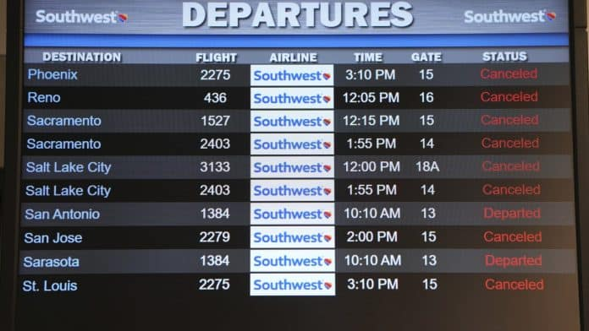
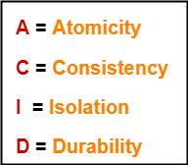
3) Consistency in Relational DBs
All systems fail
Application crash
Application error (e.g., a scenario that was non implemented, internal error)
Hardware failure (e.g., disk)
Power failure
Relational DBs enforce ACID properties
Atomicity
= transactions are all or nothing
Either a transaction (which can be composed of multiple statements) succeeds completely or fails
Atomicity needs to be guaranteed for any system failure
Consistency
= any transaction brings the DB from one valid state to another
The "invariants" of the DB (e.g., constraints, rules) must be maintained
Isolation
= if transactions are executed concurrently, the result is the same as if the transactions were executed sequentially
Durability
= once a transaction has been committed, the content is preserved for any system failure
Just record the data in non-volatile memory

Slide 10
3) Consistency in Distributed DB
Achieving ACID consistency is:
non-trivial in a single DB server setup
difficult in a distributed DB server setup
Distributed setup is needed when data scales up for:
performance (e.g., transaction per seconds)
availability (guarantees a certain up-time)
fault-tolerance (can recover from faults)

Slide 11
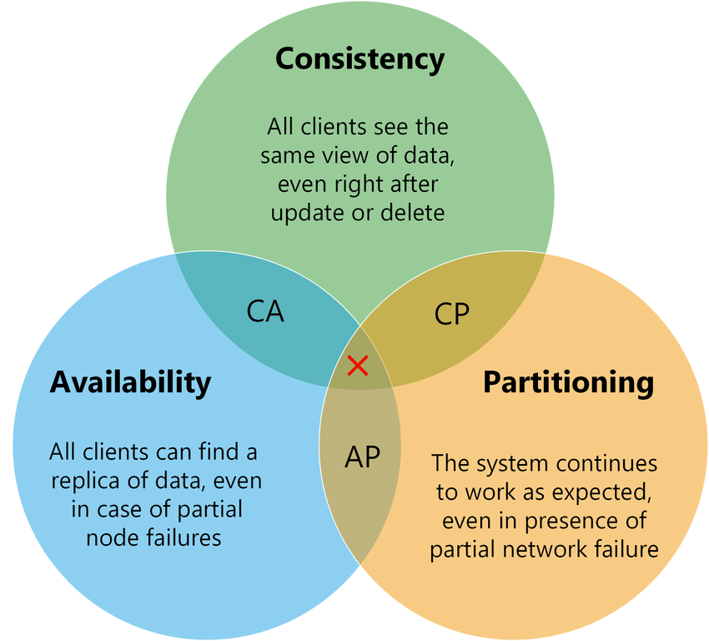
CAP Theorem
CAP theorem: Any distributed DB can have at most two of the following three properties
Consistent: writes are atomic and subsequent reads retrieve the new value
Available: a value is returned as long as a single server is running
Partition tolerant: the system still works even if communication is temporary lost (i.e., the network is partitioned)
Originally a conjecture (Eric Brewer), but made formal later (Gilbert, Lynch, 2002)
CAP corollary: Partitions cannot be prevented in large-scale distributed system, so either sacrifice:
Availability (i.e., go down): e.g., banking system
Consistency (i.e., different views of the system): e.g., social network
Notes:
Theorem: It is impossible in the asynchronous network model to implement a read/write data object that guarantees the following properties:
Availability
Atomic consistency in all fair executions (including those in which messages are lost)

Slide 12
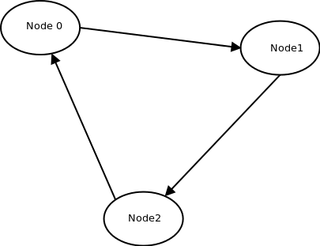
CAP Theorem: Intuition
Imagine there are 3 DB replicas
Users can access only one of them
A network partition happens and DB servers can't communicate with each other
Reads: the user can access the data of the server in the same partition
Writes: data can't be updated since multiple users might be updating the data at the same data, leading to inconsistency
CAP theorem
Let updates happen on the accessible replica at cost of inconsistency
Sometimes inconsistency is fine (e.g., social networking)
Other times it's not acceptable (e.g., a banking system) -> availability
Minimize probability of failures using redundancy and fault-tolerance

Slide 13
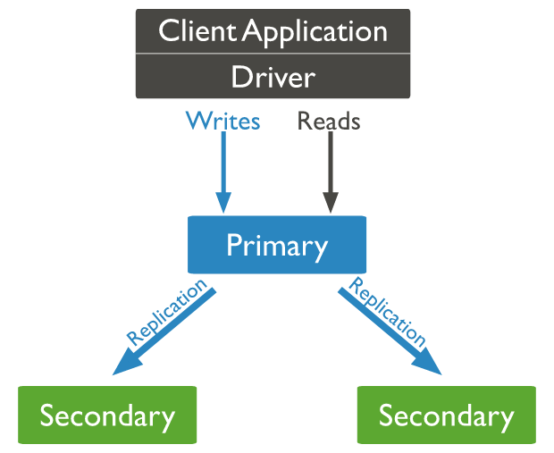
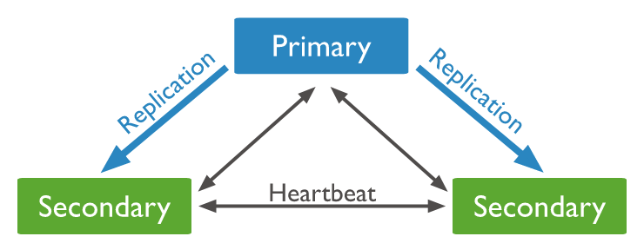
Replication Schemes
Primary-secondary replication
Aka “master-slave replication”
Replicas cannot update local data, but require primary node to perform update
Single-point of failure
Update-anywhere replication
Aka “multi-master replication”
Every replica can update a data item, which is then propagated (synchronously or asynchronously)
Quorum
Let N be the total number of replicas
When writing, we make sure to write to W replicas
When reading, we read from R replicas and pick the latest (using timestamps)

Slide 14
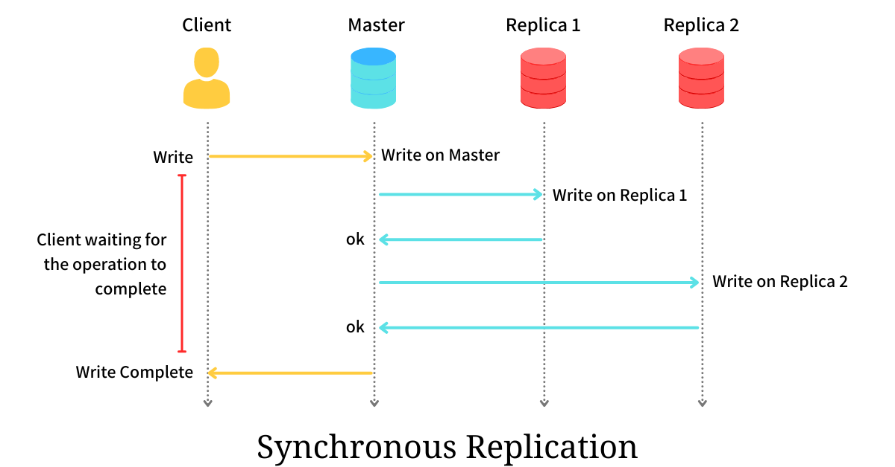
Synchronous Replication
Updates are propagated to other replicas as part of a single transaction
2-Phase Commit: Original proposal for doing this
Single point of failure
Can't handle primary server failure
Paxos: More widely used today
Doesn't require a primary
More fault tolerant
Both solutions are complex / expensive
Consistency
Availability
Fail in case of network partition (CAP theorem)
Many systems use relaxed / loose consistency models

Slide 15
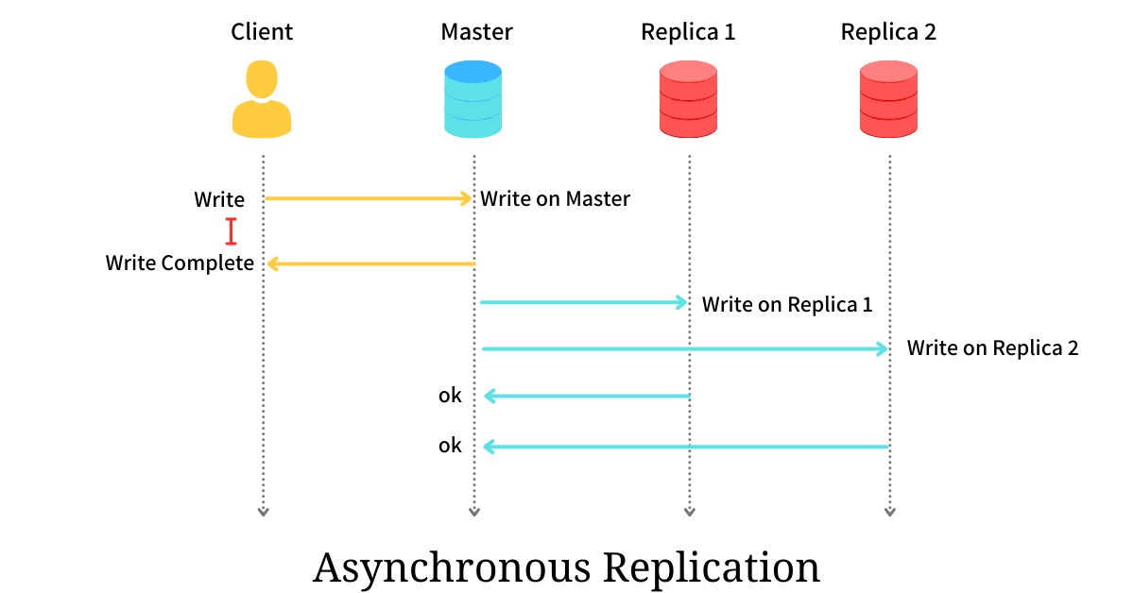
Asynchronous Replication
Aka “lazy propagation”, “eventual consistency”
The primary node propagates updates to replicas, even if there are failures
The transaction is completed before replicas are updated
Commits are quick at cost of consistency
Popularized by AWS DynamoDB
Guarantees provided only on the eventual outcome
Cannot provide guarantees about what different clients will see, in which order they will see updates, etc.
Freshness property
Since propagation of updates happens asynchronously, a read from a replica may not get the latest version of a data item
User can request a version with a certain "freshness" (e.g., data from not more than 10 minutes ago)
E.g., it's ok to show price for an airplane ticket that is few minutes old
The DB can version data with timestamps
If local replica has fresh data, uses it, otherwise send request to primary node

Slide 16
BASE Consistency
Basically Available
Soft state
Each replica can have a different state after partitioning
Eventually consistent
Once the partitioning is resolved, all replicas will become eventually consistent
E.g., merge updates in a meaningful way (e.g., by timestamp)

Slide 17
4) Scalability Issues with RDMS
Source of relational DB scalability issues
a) Locking data
The DB engine needs to lock rows and tables to ensure ACID
When DB locked:
higher latency ->
less updates per second ->
slower application
b) Scaling out
Scaling out requires replicating data over multiple servers makes thing worse
To enforce DB consistency, locks are applied across networks -> application even slower

Slide 18
Scalability Issues with RDMS: Solutions
Table denormalization
= strategy used to increase relational DB read performance by adding redundant data
Lock only one table, instead of multiple ones
Pros:
Reads become faster
Cons:
Writes become slower (more tables to update)
If we join the tables, we lose relations between tables (the main reason of using a relational DB)
Relax consistency
NoSQL

Slide 19
NoSQL Stores
Geared toward the use case of large-scale web applications
Need real-time access with a few ms latencies
E.g., Facebook == 4ms for reads
Solve problems with using relational databases
Too slow
Don't need ACID properties
Must give up something if you want to really scale
Give up consistency
Give up joins
Most NoSQL stores don't allow joins
Instead require data to be denormalized and duplicated
Only allow restricted transactions
Most NoSQL stores will only allow one object transactions
E.g., one document / key

Slide 20
Relational DB vs MongoDB
1) Application-DB impedance mismatch
2) Schema flexibility
No schema, no tables, no rows, no columns, no relationships between tables
3) Consistency in distributed set-up
Wait until primary and secondary servers are updated
Wait until the majority of secondary servers are updated
Wait until only the primary is updated
Not even wait until the primary persisted the data ("fire and forget")
Eventual consistency in case of replication
If you have multiple servers, your document eventually will make it over to the secondary servers
Synchronous / asynchronous updates
4) Scalability
Updating data means locking only one document, and not entire collection
Use more machines to do collectively do more work

Slide 21
UMD DATA605 - Big Data Systems NoSQL Stores
NoSQL Taxonomy
(Apache) HBase

Slide 22
Resources
Slides
Silbershatz Chap 23.6
Mastery:
Seven Databases in Seven Weeks, 2e

Slide 23
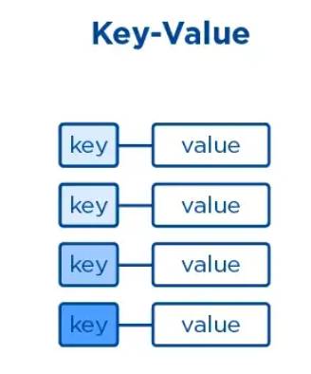
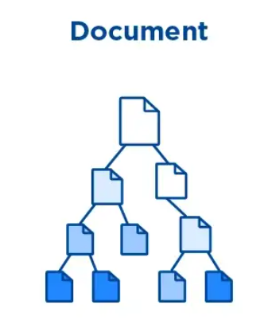
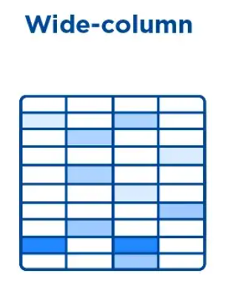
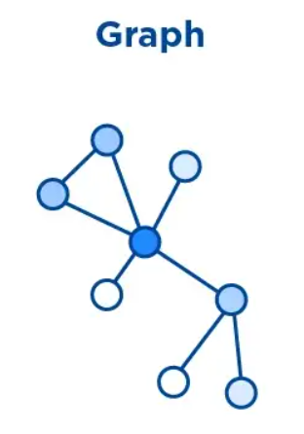
DB Taxonomy
At least five DB genres:
Relational
Key-value
Columnar
Document
Graph
Criteria to differentiate DBs
Data model
Trade-off with respect to CAP
Querying capability
Replication scheme

Slide 24
Relational DBs
E.g., Postgres, MySQL, Oracle, SQLite
Data model
Based on set-theory and relational algebra
Data as two dimensional tables with rows and columns
Many attribute types (e.g., numeric, strings, dates, blobs, arrays)
Attribute types are strictly enforced
SQL query language
ACID consistency
Application:
Any relational tabular data
Good for:
Useful when layout of data is known, but not the data access pattern
Complexity upfront (for schema) to achieve query flexibility
Used when data is regular
Not so good for:
When data structure is variable (record to record variation) or hierarchical

Slide 25
Key-Value Store
E.g., Redis, DynamoDB, filesystem, Git
Data model
Maps simple keys (e.g., strings) to more complex values (e.g., nested hash table)
Support get, put, and delete operations on a primary key
Application
E.g., store users' session data in a web application
E.g., caching data
Good for
Useful when data are not "related" (e.g., no joins)
Lookups are fast
Easy to scale horizontally using partitioning scheme
Not so good for
Lacking secondary indexes and scanning capabilities
Not great if data queries are needed

Slide 26
Columnar Store
E.g., HBase, Cassandra, Parquet
Data model
Data is stored by columns (instead of rows like in relational DBs)
Share similarities with both key-value and relational DBs
Values are queried by matching keys, like key-value
Values are groups of zero or more columns, like relational
Application
E.g., storing web-pages
Good for
Horizontal scalability
Enable compression and versioning
Tables can be sparse without extra storage cost
Columns are inexpensive to add
Not so good for
Adding rows is expensive
You need to design the schema based on how you plan to query the data
No native joins, applications need to handle join

Slide 27
Document Store
E.g., MongoDB, CouchDB
Data model
Allow for any number of fields per object, even nested
E.g., JSON, XML
Each document has a unique ID (e.g., hash)
Since documents are not related, it's easy to shard and replicate
Application
Any semi-structured data
Good for
When you don't know how your data will look like
Map well to OOP models (less impedance mismatch between application and DB)
Not so good for
Complex join queries on normalized data not possible
Denormalized form is the norm

Slide 28
Graph DBs
E.g., Neo4J
Data model
Highly interconnected data, storing nodes and relationships between nodes
Both nodes and edges have properties (i.e,. key-value pairs)
Queries involve traversing nodes and relationships to find relevant data
Applications
E.g., social data, recommendation engines, geographical data
Good for
Perfect for "networked data", which is difficult to model with relational model
Good match for OO systems
Not so good for
Don't scale well, since it's difficult to partition graph on different computing nodes
Store the graph in the graph DB and the relations in a key-value store

Slide 29
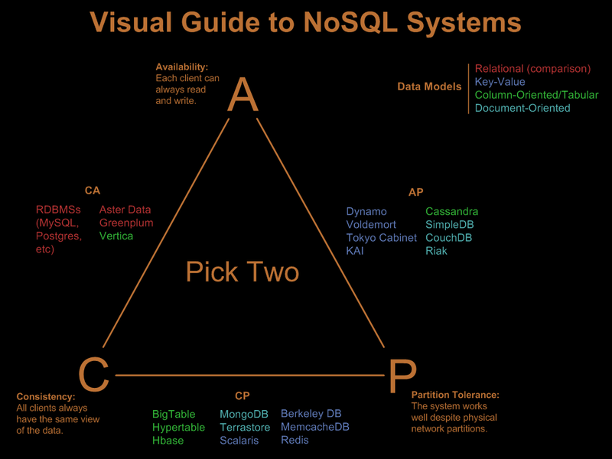
Taxonomy by CAP
From http://blog.nahurst.com/visual-guide-to-nosql-systems

Slide 30
Taxonomy by CAP
CA (Consistent, Available) systems
Have trouble with partitions and typically deal with it with replication
E.g.,
traditional RDBMSs like PostgreSQL, MySQL
CP (Consistent, Partition-Tolerant) systems
Have trouble with availability while keeping data consistent across partitioned nodes
E.g.,:
BigTable (column-oriented/tabular)
HBase (column-oriented/tabular)
MongoDB (document-oriented)
Redis (key-value)
MemcacheDB (key-value)
Berkeley DB (key-value)
AP (Available, Partition-Tolerant) systems
Achieve "eventual consistency" through replication and verification
E.g.,:
Dynamo (key-value)
Cassandra (column-oriented/tabular)
CouchDB (document-oriented)

Slide 31
UMD DATA605 - Big Data Systems NoSQL Stores
NoSQL Taxonomy
(Apache) HBase

Slide 32
Resources
Slides
Web
2006, BigTable paper
https://hbase.apache.org/
https://github.com/apache/hbase
Mastery:
Seven Databases in Seven Weeks, 2e

Slide 33

(Apache) HBase
HBase = Hadoop DataBase
Very large tables on clusters of commodity hardware
Column oriented
Uses Hadoop filesystem (HDFS)
HBase based on Google BigTable and then open-sourced
HDFS modeled on Google FileSystem (GFS)
In fact Google BigTable runs on GFS
Part of Apache Hadoop ecosystem
Used at Airbnb, Google, eBay
Use HBase
For large DBs (e.g., at least many 100 GBs or TBs)
When having at least 5 nodes in production
Applications
Large-scale online analytics
Heavy-duty logging
Search systems (e.g., Internet search)
Facebook Messages, search indexing, stream analysis
Twitter metrics monitoring

Slide 34
HBase: Features
Data versioning
Data compression
Garbage collection (for expired data)
In-memory tables
Atomicity (at row level)
Strong consistency guarantees
Fault tolerant (for machines and network)
Write-ahead logging
Write data to an in-memory log before it's written to disk
Distributed configuration
Nodes can rely on each other rather than on a centralized source

Slide 35
From HDFS to HBase
Different types of workloads
OLAP (On-Line Analytical Processing)
Read continuously large amount of data and process it
E.g., analyze item purchases over time
OLTP (On-Line Transactional Processing)
Read and write individual data items in a large table
E.g., update inventory and price as orders come in
Hadoop FileSystem (HDFS) supports OLAP workloads
Provide a filesystem consisting of arbitrarily large files
Data should be read sequentially, end-to-end
Rarely updated
HBase supports OLTP interactions
Built on top of HDFS
Use additional storage and memory to organize the tables
Write tables back to HDFS as needed

Slide 36
HBase Data Model
Warning: HBase uses names similar to relational DB concepts but with different meanings
A database consists of multiple tables
Each table consists of multiple rows, sorted by row key
Each row contains a row key and one or more column families
Each column family
is defined when the table is created
can contain multiple columns (family:column)
A cell
is uniquely identified by (table, row, family:column)
contains metadata (e.g., timestamp) and an uninterpreted array of bytes (blob)
Versioning
New values don't overwrite the old ones
`put` and `get` allow to specify a timestamp (otherwise uses current time)
Database = Dict[TableName, Table]
# Table
hbase_table = {
# Row key
'row1': {
# (column family, column)
# -> value
'cf1:col1': 'value1',
'cf1:col2': 'value2',
'cf2:col1': 'value3'
},
'row2': {
… # More row data
}
}
database = {'table1': hbase_table}
# Querying data.
(value, metadata) = hbase_table[
'row1']['cf1:col1']

Slide 37
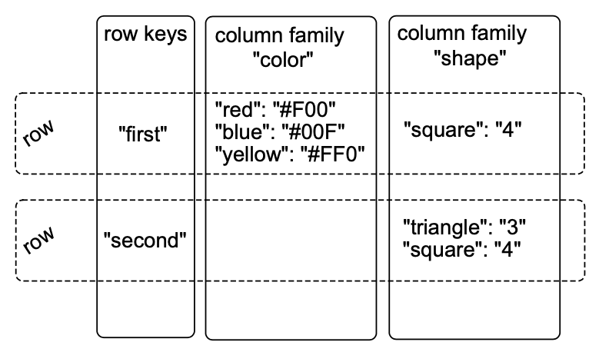
Example 1
Table with:
2 column families (“color” and “shape”)
2 rows (“first” and “second”)
The row “first” has:
3 columns in the column family “color” (“red”, “blue”, “yellow”)
1 column in the column family “shape”
The row “second” has:
no columns in “color”
2 columns in the column family “shape”
Using row key and column (family:qualifier) locate the data
table = {
'first': {
# (column family, column) -> value
'color': {'red': '#F00',
'blue': '#00F',
'yellow': '#FF0'}
'shape': {'square': 4}
},
'second': {
'shape': {'triangle': 3,
'square': 4}
}
}

Slide 38
Why all this convoluted stuff?
Rows in HBase are "deeper" than in other DBs
In relational DBs rows contain a lot of column values (fixed array with types)
In HBase rows contain something like a two-level nested dictionary and metadata (e.g., timestamp)
Intuition: a row in HBase is almost like a mini-database
A cell has many different values associated with it
Data is stored in a sparse format
A natural application: store versioned web-site data

Slide 39
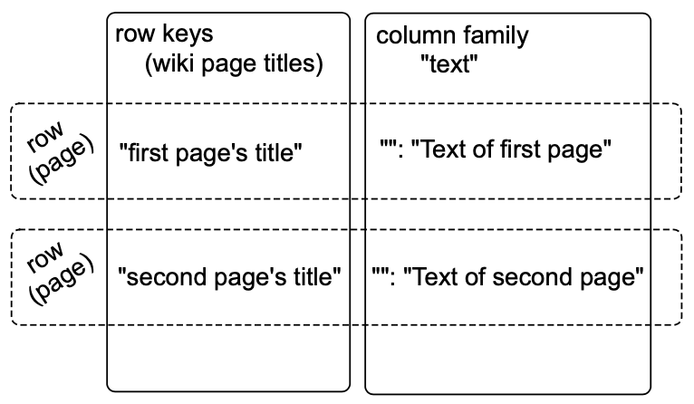
Example 2: Storing a Wiki
Wiki contains pages
Each page has a title string and an article text
HBase data model
Table -> `wiki`
Row -> entire wiki page
Row keys -> wiki identifier (e.g., title, URL, path)
Column family -> `text`
Column -> not defined, ‘’ (empty)
Cell value -> article text
Add data
Columns don't need to be predefined when creating a table
The column is defined as `text:`
> put 'wiki', 'Home', 'text:', 'Welcome to the wiki!'
Query data
Specify the table name, the row key, and optionally a list of columns
> get 'wiki', 'Home', 'test:'
COLUMN CELL
text: timestamp=1295774833226, value=Welcome to the wiki!
HBase returns the timestamp (ms since the epoch 01-01-1970 UTC)
Database = Dict[TableName, Table]
wiki_table = {
# wiki id.
'Home': {
# Column family, column
# -> value
'text:': 'Welcome to the wiki!',
},
'row2': {
… # More row data
}
}
database = {'wiki': wiki_table}
(queried_value, metadata) = wiki_table[
'Home']['text:']

Slide 40
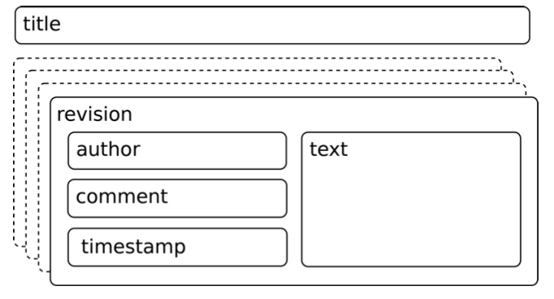
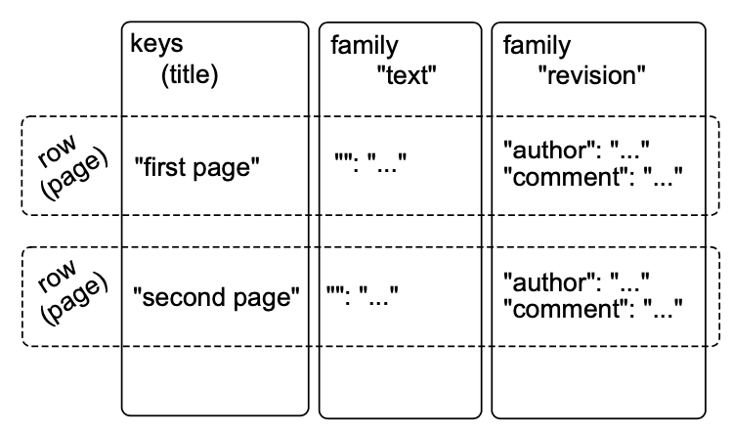
Example 2: Improved Wiki
Improved wiki using versioning
A page
is uniquely identified by its title
can have unlimited revisions
A revision
is identified by its timestamp
contains text and optionally a commit comment
is made by an author, identified by name
Data model
Add a family column “revision” with multiple columns (e.g., author, comment, ...)
Timestamp is automatic and binds article text and metadata
The title is not part of the revision
It's fixed and identified uniquely the page
If you want to change the title you need to re-write all the row
HBase can specify default values for every cell

Slide 41
Data in Tabular Form
 | Name |  | Home |  | Office
Key | First | Last | Phone | Email | Phone | Email
101 | Florian | Krepsbach | 555-1212 | florian@wobegon.org | 666-1212 | fk@phc.com
102 | Marilyn | Tollerud | 555-1213 |  | 666-1213
103 | Pastor | Inqvist |  |  | 555-1214 | inqvist@wel.org

Slide 42
Fundamental Operations
CREATE table, families
PUT table, rowid, family:column, value
PUT table, rowid, whole-row
GET table, rowid
SCAN table (WITH filters)
DROP table

Slide 43
Data in Tabular Form
 | Name |  |  | Home |  | Office |  | Social
Key | First |  | Last | Phone | Email | Phone | Email | FacebookID
101 | Florian | Garfield | Krepsbach | 555-1212 | florian@wobegon.org | 666-1212 | fk@phc.com
102 | Marilyn |  | Tollerud | 555-1213 |  | 666-1213
103 | Pastor |  | Inqvist |  |  | 555-1214 | inqvist@wel.org
New columns can be
added at runtime
Column families cannot be added at runtime
Table People (Name, Home, Office)
{
101: {
Timestamp: T403;
Name: {First=“Florian”, Middle=“Garfield”, Last=“Krepsbach”},
Home: {Phone=“555-1212”, Email=“florian@wobegon.org”},
Office: {Phone=“666-1212”, Email=“fk@phc.com”}
},
102: {
Timestamp: T593;
Name: {First=“Marilyn”, Last=“Tollerud”},
Home: {Phone=“555-1213”},
Office: {Phone=“666-1213”}
},
…
}

Slide 44
Nested Data Representation
 | Name |  | Home |  | Office
Key | First | Last | Phone | Email | Phone | Email
101 | Florian | Krepsbach | 555-1212 | florian@wobegon.org | 666-1212 | fk@phc.com
102 | Marilyn | Tollerud | 555-1213 |  | 666-1213
103 | Pastor | Inqvist |  |  | 555-1214 | inqvist@wel.org
GET People:101
101: {
Timestamp: T403;
Name: {First=“Florian”, Middle=“Garfield”, Last=“Krepsbach”},
Home: {Phone=“555-1212”, Email=“florian@wobegon.org”},
Office: {Phone=“666-1212”, Email=“fk@phc.com”}
}
GET People:101:Name
People:101:Name: {First=“Florian”, Middle=“Garfield”, Last=“Krepsbach”}
GET People:101:Name:First
People:101:Name:First=“Florian”

Slide 45
Column Family vs Column
Adding a column family
can’t be done at run-time
need a copy operation (expensive)
Adding a column
is cheap
can be done at run-time
Why column families vs columns?
Why not store all row data in a single column?
Each column family can be configured independently from each other
E.g.,
compression
performance tuning
stored together

Slide 46
Consistency Model
Atomicity:
Entire rows are updated atomically or not at all
Independently of how many columns are affected
Consistency:
A GET is guaranteed to return a complete row that existed at some point in the table’s history
Check the timestamp to be sure!
A SCAN
must include all data written prior to the scan
may include updates since it started
Isolation:
Not guaranteed outside a single row
Durability:
All successful writes have been made durable on disk

Slide 47
Checking for Row or Column Existence
HBase supports Bloom filters to check whether a row or column exists
It's like a cache for `key in keys` instead of `keys[key]`
E.g., instead of querying one can keep track of what's present
Bloom filter implementation
Bloom filter is like a probabilistic hash set
Array of bits initially all equal to 0
When a new blob of data is presented, turning the blob into a hash, and then using that to set some bits to 1
To test if we have seen a blob, compute the bits and check
If all bits are 0s, then for sure we didn't see it
If all bits are 1s, then we might have seen that blob
Hash
Space needed to store data is unbounded
No false positives
O(1) in average
Bloom filter
Use a constant amount of space
Have false positives
O(1)

Slide 48
Write-Ahead Log (WAL)
HBase uses WAL
It is a disaster recovery technique to provide atomicity and durability, protecting against node failures
Equivalent to journaling in file system
For performance reasons, the updated state of the tables are
Not written to disk immediately
Buffered (in memory) and written to disk as checkpoints
Problem
If the server crashes during this limbo period, the state is lost
Solution
Use append-only disk-resident structure
Log of operations performed since last table checkpoint are appended to the WAL (it’s like storing deltas)
When tables are stored to disk, WAL is cleared
If the server crashes during the limbo period, use WAL to recover the state that was not written yet
When running a big import job, disable the WAL to improve performance
Trade off disaster recovery protection for speed

Slide 49
HBase Implementation
HBase is backed by HDFS
“One file” means one gigantic file stored in HDFS
Not to worry about the details of how the file is split into blocks
Here is the idea in several steps:
Idea 1: Put an entire table in one file
Need to overwrite the file every time there is a change in any cell
Too slow
Idea 2: One file + WAL
Better, but doesn’t scale to large data
Idea 3: One file per column family + WAL
Getting better!
Idea 4: Partition table into regions by key
Region = a chunk of rows [a, b)
Regions never overlap

Slide 50
Idea 1: Put the Table in a Single File
File “People”
101: {Timestamp: T403; Name: {First=“Florian”, Middle=“Garfield”, Last=“Krepsbach”},Home: {Phone=“555-1212”, Email=“florian@wobegon.org”},Office: {Phone=“666-1212”, Email=“fk@phc.com”}},
102: {Timestamp: T593;Name: { First=“Marilyn”, Last=“Tollerud”},Home: { Phone=“555-1213” },Office: { Phone=“666-1213” }}, . . .
How do we do the following operations?
CREATE
DELETE
SCAN
GET
PUT

Slide 51
Variable-Length Data
SQL Table: People( ID: Integer, FirstName: CHAR[20], LastName: Char[20], Phone: CHAR[8] )
UPDATE People SET Phone=“555-3434” WHERE ID=403;
ID FirstName LastName Phone
101 Florian Krepsbach 555-3434
102 Marilyn Tollerud 555-1213
103 Pastor Ingvist 555-1214
Each row is exactly 52 bytes long.
To move to the next row, just fseek(file,+52);
To get to Row 401, fseek(file,401*52);
Overwrite the data in place.
HBase Table People( ID, Name, Home, Office )
PUT People, 403, Home:Phone, 555-3434
101: {Timestamp: T403;Name: {First=“Florian”, Middle=“Garfield”, Last=“Krepsbach”},Home: {Phone=“555-1212”, Email=“florian@wobegon.org”},Office: {Phone=“666-1212”, Email=“fk@phc.com”}},
102: {Timestamp: T593;Name: { First=“Marilyn”, Last=“Tollerud”},Home: { Phone=“555-1213” },Office: { Phone=“666-1213” }}, . . .
?
Fun reading on the topic:
http://www.joelonsoftware.com/articles/fog0000000319.html

Slide 52
Idea 2: One Table + Transaction Log
Table for People
101: {Timestamp: T403;Name: {First=“Florian”, Middle=“Garfield”, Last=“Krepsbach”},Home: {Phone=“555-1212”, Email=“florian@wobegon.org”},Office: {Phone=“666-1212”, Email=“fk@phc.com”}},
102: {Timestamp: T593;Name: { First=“Marilyn”, Last=“Tollerud”},Home: { Phone=“555-1213” },Office: { Phone=“666-1213” }}, . . .
Transaction Log for Table People:
Memory Cache for Table People:
PUT 101:Office:Phone = “555-3434”
PUT 102:Home:Email = mt@yahoo.com
….
101
102
Changes are applied only to the log file,
Then the resulting record is cached in memory.
Reads must consult both memory and disk.
GET People:101
GET People:103
PUT People:101:Office:Phone = “555-3434”

Slide 53
Idea 2 Requires Periodic Table Update
Table for People on Disk: (Old)
101: {Timestamp: T403;Name: {First=“Florian”, Middle=“Garfield”, Last=“Krepsbach”},Home: {Phone=“555-1212”, Email=“florian@wobegon.org”},Office: {Phone=“666-1212”, Email=“fk@phc.com”}},
102: {Timestamp: T593;Name: { First=“Marilyn”, Last=“Tollerud”},Home: { Phone=“555-1213” },Office: { Phone=“666-1213” }}, . . .
Transaction Log for Table People:
Write out a new copy of the table, with all of the changes applied
Delete the log and memory cache, and start over.
PUT 101:Office:Phone = “555-3434”
PUT 102:Home:Email = mt@yahoo.com
….
Table for People on Disk: (New)
101: {Timestamp: T403;Name: {First=“Florian”, Middle=“Garfield”, Last=“Krepsbach”},Home: {Phone=“555-1212”, Email=“florian@wobegon.org”},Office: {Phone=“555-3434”, Email=“fk@phc.com”}},102: {Timestamp: T593;Name: { First=“Marilyn”, Last=“Tollerud”},Home: { Phone=“555-1213”, Email=“my@yahoo.com” }, . . .

Slide 54
Idea 3: Partition by Column Family
Tables for People on Disk: (Old)
Data for
Column Family
Name
Data for
Column Family
Home
Data for
Column Family
Office
Transaction Log for Table People:
Write out a new copy of the tablet, with all of the changes applied
Delete the log and memory cache
Start over
PUT 101:Office:Phone = “555-3434”
PUT 102:Home:Email = mt@yahoo.com
….
Tables for People on Disk: (New)
Data for
Column Family
Name
Data for
Column Family
Home (Changed)
Data for
Column Family
Office (Changed)

Slide 55
Idea 4: Split Into Regions
HBase
Client
Access data in tables
(Detail of One Region Server)
Where are the servers for table People?
Region
Server
Region 1: Keys 100-200
Table
Column
Family Name
Region
Server
Memory Cache
Region 2: Keys 100-200
Region
Master
Table
Column
Family Home
Region
Server
Region 3: Keys 100-200
Transaction Log
Region
Server
Table
Column
Family Office
Region 4: Keys 100-200

Slide 56
Column Family Name
Column Family Home
Column Family Office
Region 1
Keys 101-200
Region 2
Keys 201-300
Table People
Region 3
Keys 301-400

